Slide 1

Dr. Weather
Team:
Samuel SunilKumar (TL)
John Steele
Lakshmi Sravani Badam
Poorvi Raut

Slide 2
Index
Introduction
Dr. Weather
Large Language Model
Data Overview
RAG
Interface and Demo

Slide 3
Introduction

Slide 4

What is Meteorology
Weather Science: Studies the Earth’s atmosphere to understand and forecast weather and climate patterns.
Key Factors: Analyzes temperature, humidity, air pressure, wind, and precipitation.
Tools & Methods: Uses data from satellites, radar, and weather stations, along with mathematical models.
Practical Importance: Supports safety, agriculture, aviation, and disaster response during extreme weather events.

Slide 5
Dr. Weather – Expert AI Meteorologist

Slide 6
What is Dr. Weather?
Dr. Weather is an advanced AI engineered to provide comprehensive and accurate weather-related information.
Dr. Weather uses advanced OpenAI models like GPT-4 to generate responses to user queries.
The responses are generated based on a comprehensive, expert-verified knowledge base.

Slide 7
Why We Need Dr. Weather ?
Getting detailed weather info is often inefficient and can be inaccurate due to scattered sources.
Plus, relying on general AI for weather questions can result in shallow and factually weak responses.

Slide 8
Advantages:
Improved Accuracy and Reliability: Enhances response quality by grounding answers in trusted, domain-specific meteorological data.
Efficient Information Retrieval: Streamlines access to precise weather information with sources, eliminating the need to manually search through extensive documents.

Slide 9
Large Language Model
&
Embeddings

Slide 10
A Large Language Model is an AI trained on vast text data
Generate human-like language for tasks such as answering questions, writing, and translating.
We guide the model's responses using carefully Engineered prompts
Model: gpt-4.1-nano-2025-04-14
Features - Trained up to June '24
"Nano": Smaller & faster than other gpt-4.1.
1M token context window

Slide 11

Embedding
Embedding converts text into numerical vectors that represent its meaning.
It allows machines to compare content based on semantic similarity.
Embedding enables more accurate search and retrieval of relevant information.
Embedding Model: text-embedding-3-small

Slide 12
Data Collection

Slide 13
File Type | Source | Retrieval Method | Type of Data
csv, json | visualcrossing.com | VisualCrossing’s API | Historical weather data for Atlanta GA & London UK
docx | wikipedia.org | Downloaded PDFs Manually | Subjects - Forest Meteorology, Synoptic Meteorology, Weather Forecasting, and Weather Maps
html | noaa.gov | Downloaded web-pages manually | Subjects - Clouds, Derechos, Lightning, and Tsunamis
pdf | wikipedia.org | Downloaded PDFs Manually | Subjects - Atmospheric Convection and Katabatic Wind
txt | visualcrossing.com | VisualCrossing’s API | Reference guide for the VisualCrossing data

Slide 14
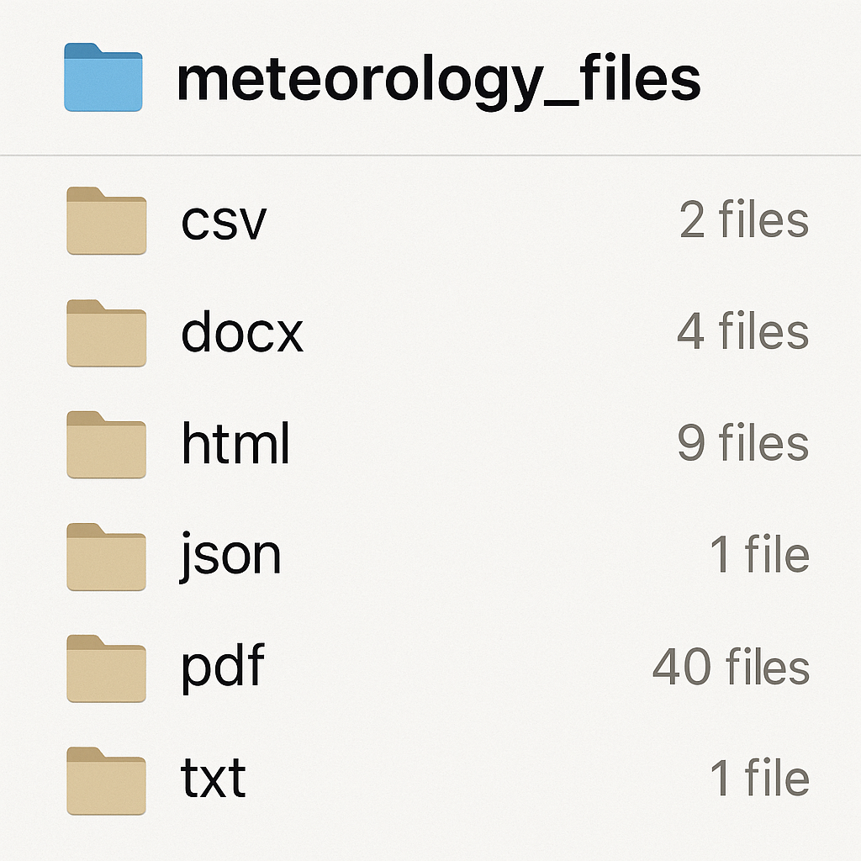
EDA and local storage layout
Cleaning of data was not required as all data came already prepared.

Slide 15
RAG Pipeline

Slide 16
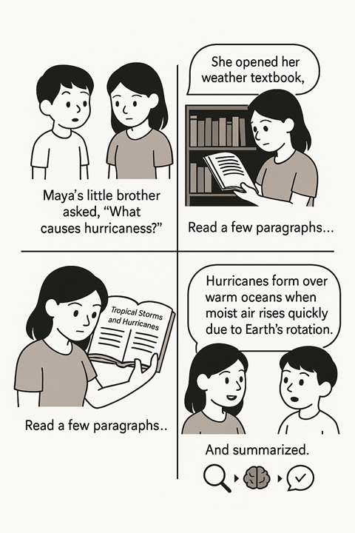
How a Human Does It:
Someone asks, “What causes hurricanes?”
Open a textbook (PDF, DOCX, etc.)
Search or skim for “hurricanes”
Read the relevant section
Understand and summarize the answer

Slide 17
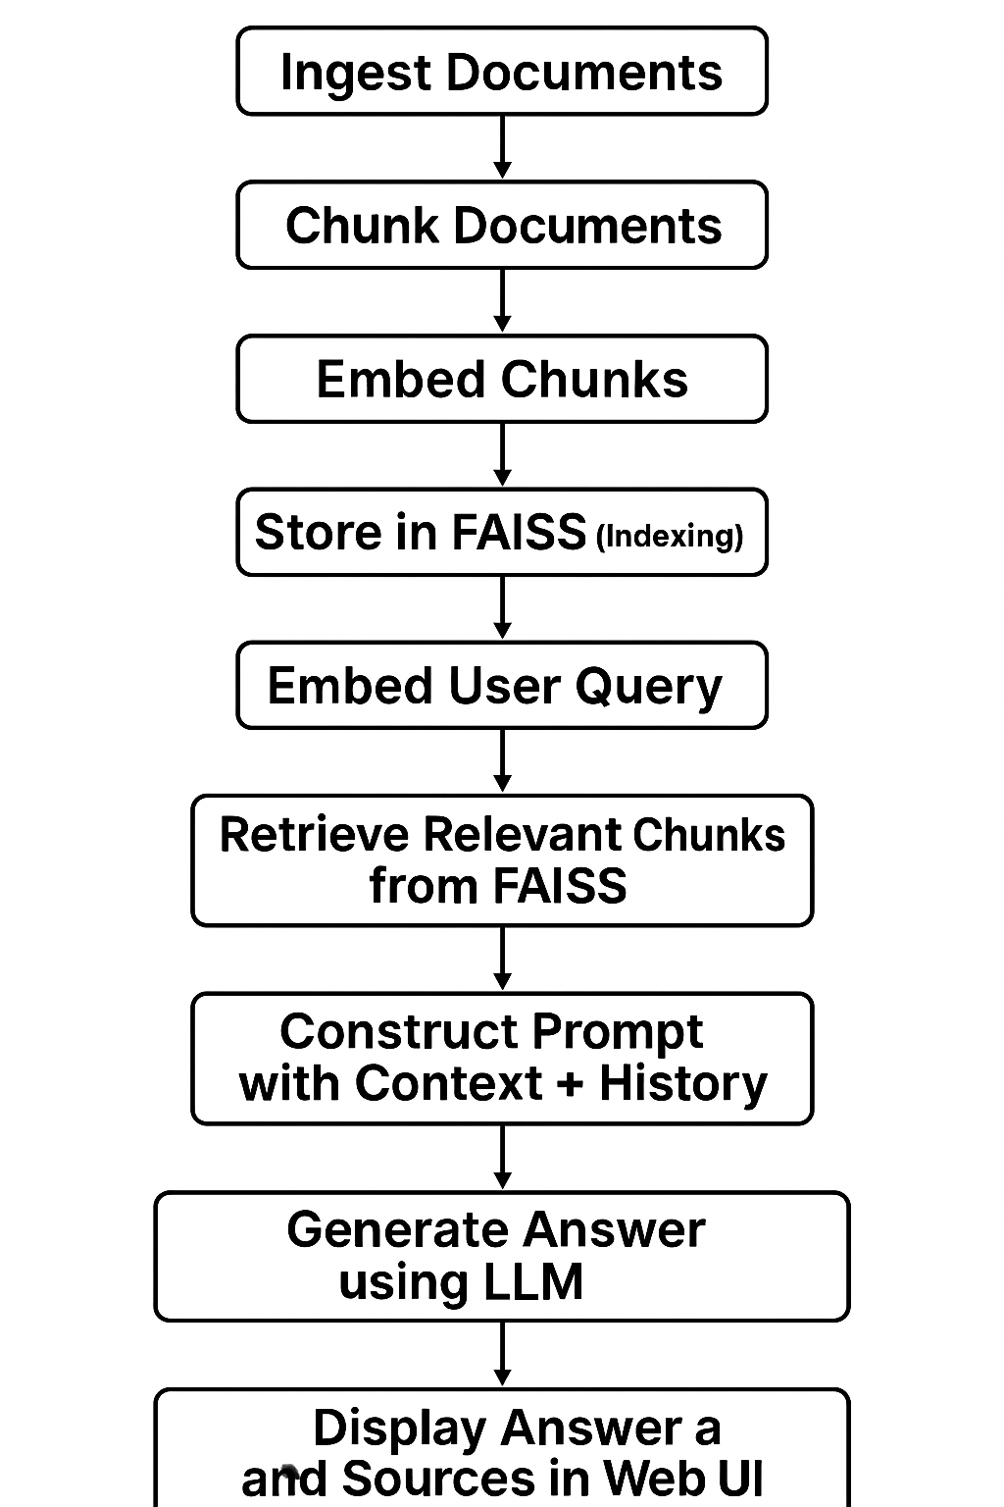
How a RAG Engine Does It:
Embedding Documents
Storing Vectors
Embedding User Queries
Retrieving Relevant Chunks

Slide 18
Application

Slide 19
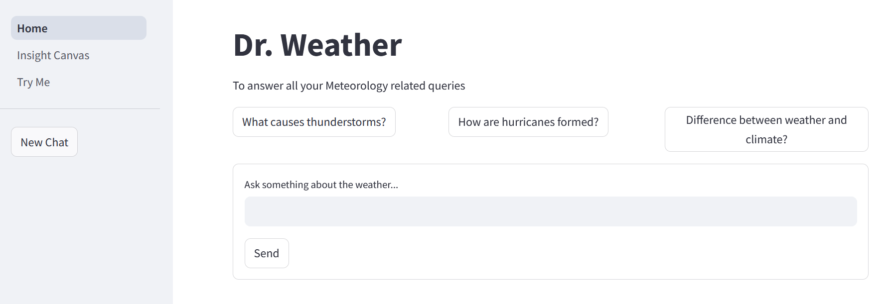
Home Screen

Slide 20
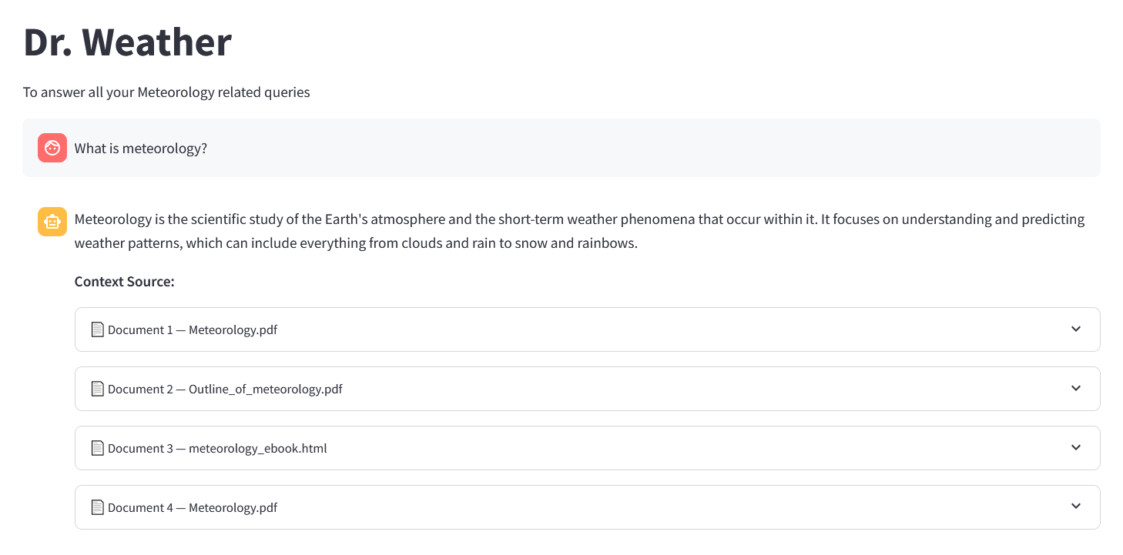
Example Prompt

Slide 21
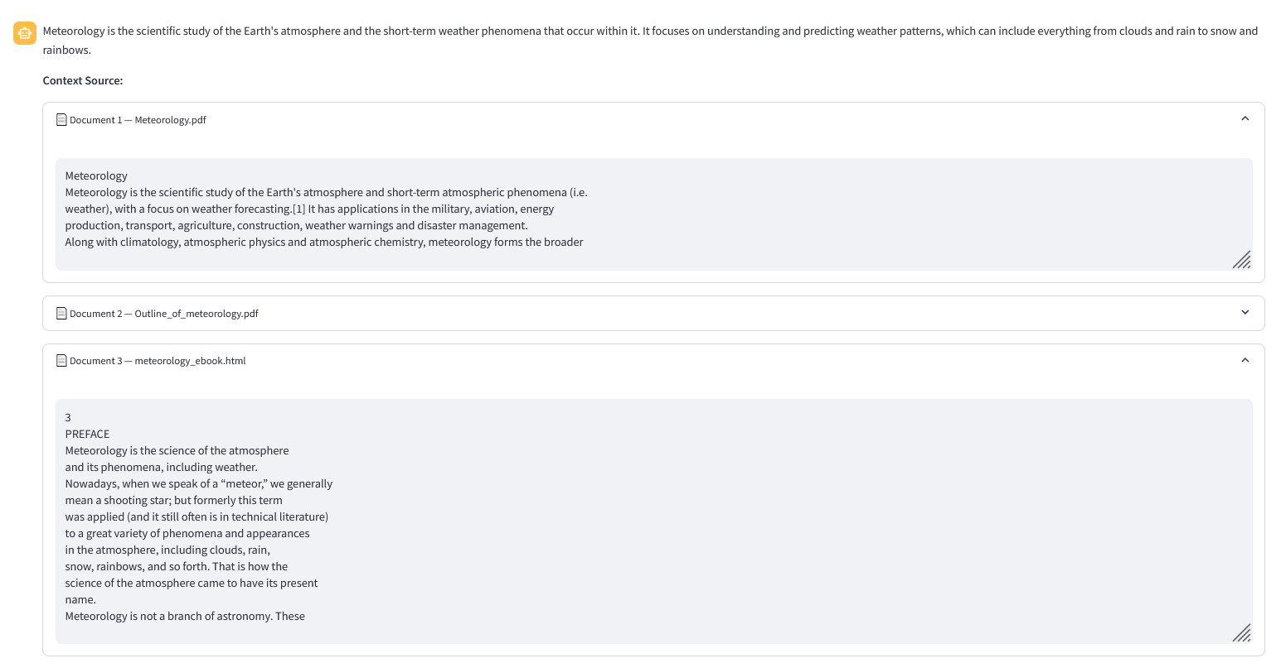

Slide 22
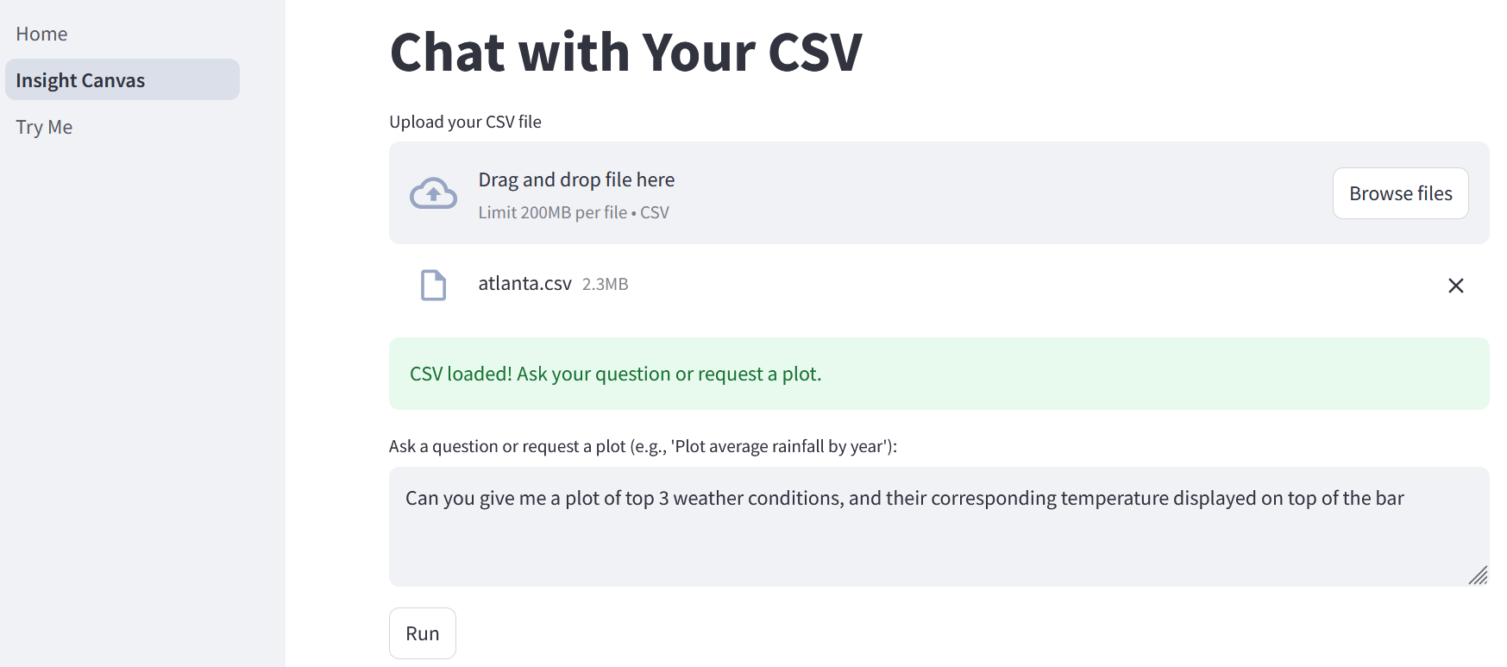
Page 2: Insights Canvas

Slide 23
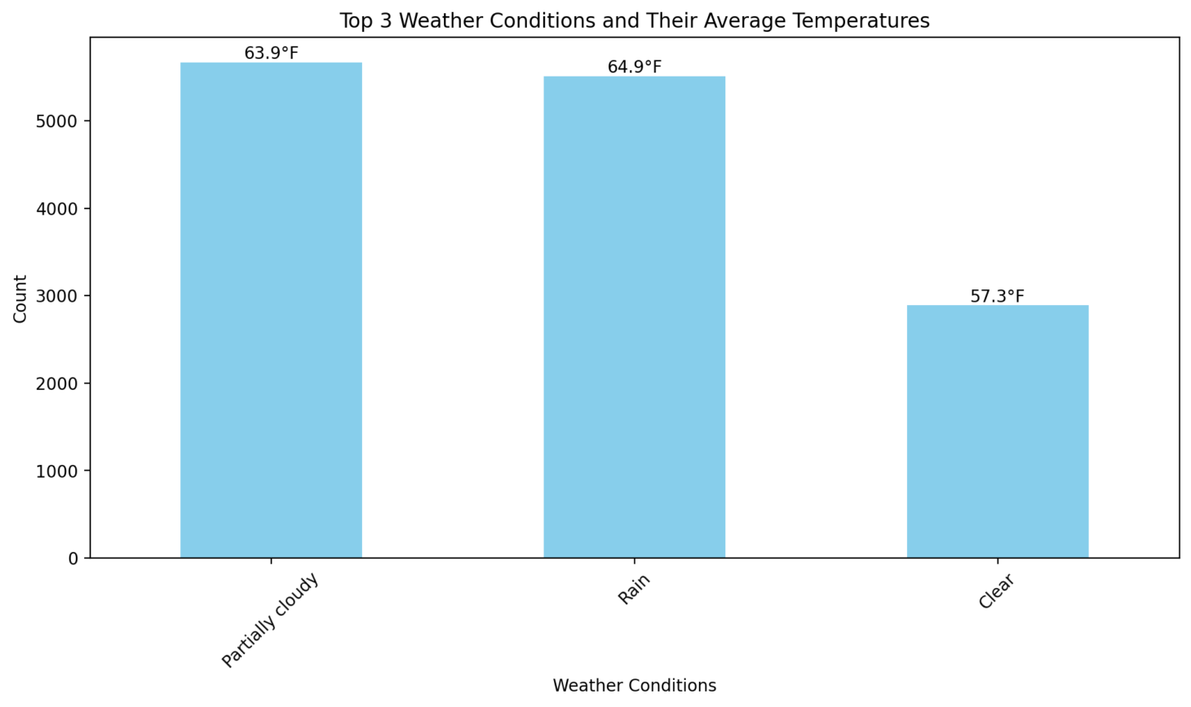
Output

Slide 24

Challenges

Slide 25
Idea Brainstorming
Data Collection
Data Integration into App – Reloading vector store multiple times
Prompt Engineering – Small talk and irrelevant prompts by users
GitHub Issues – API key pushes, branch merges
Code Base Consolidation and Refactoring

Slide 26
Thank You
Q&A

